Slide 1
Microbial community ecology using amplicon sequencing
Day 1
Goals:
Load raw amplicon sequence data into R
Visualize the quality of the data
Filter and trim low-quality parts of the data
Dereplicate data, merge into ASVs and create an ASV table

Slide 2
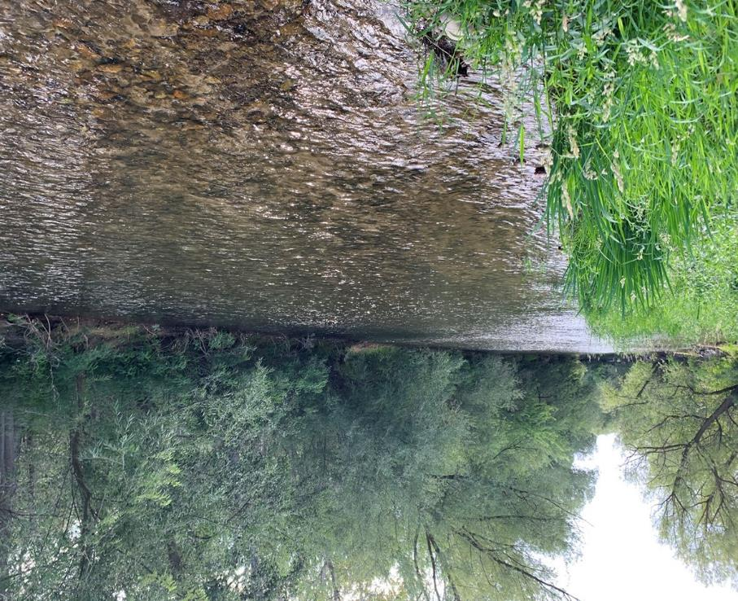
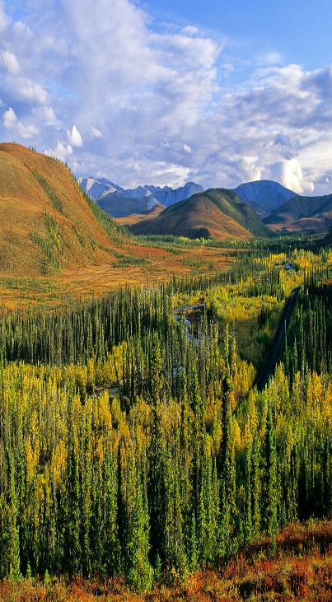
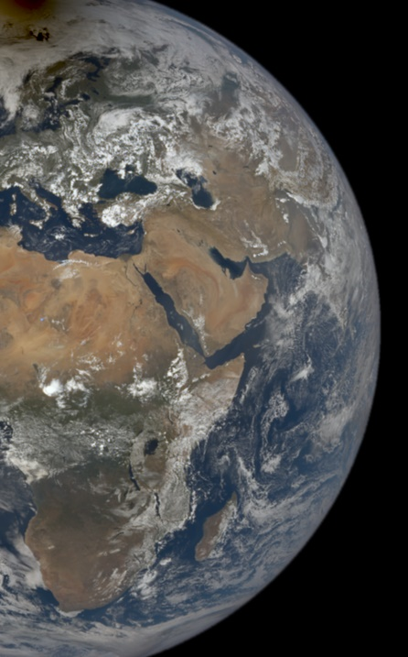
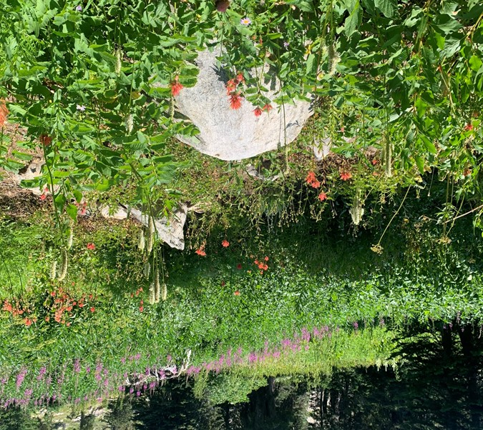
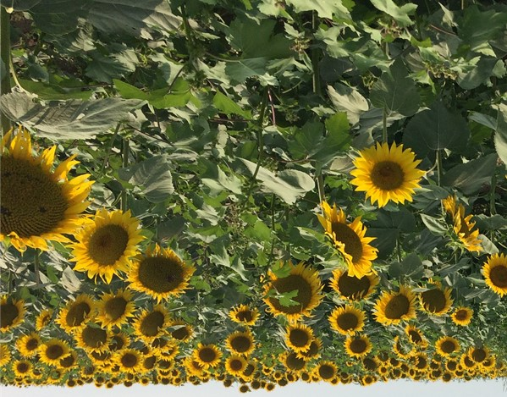
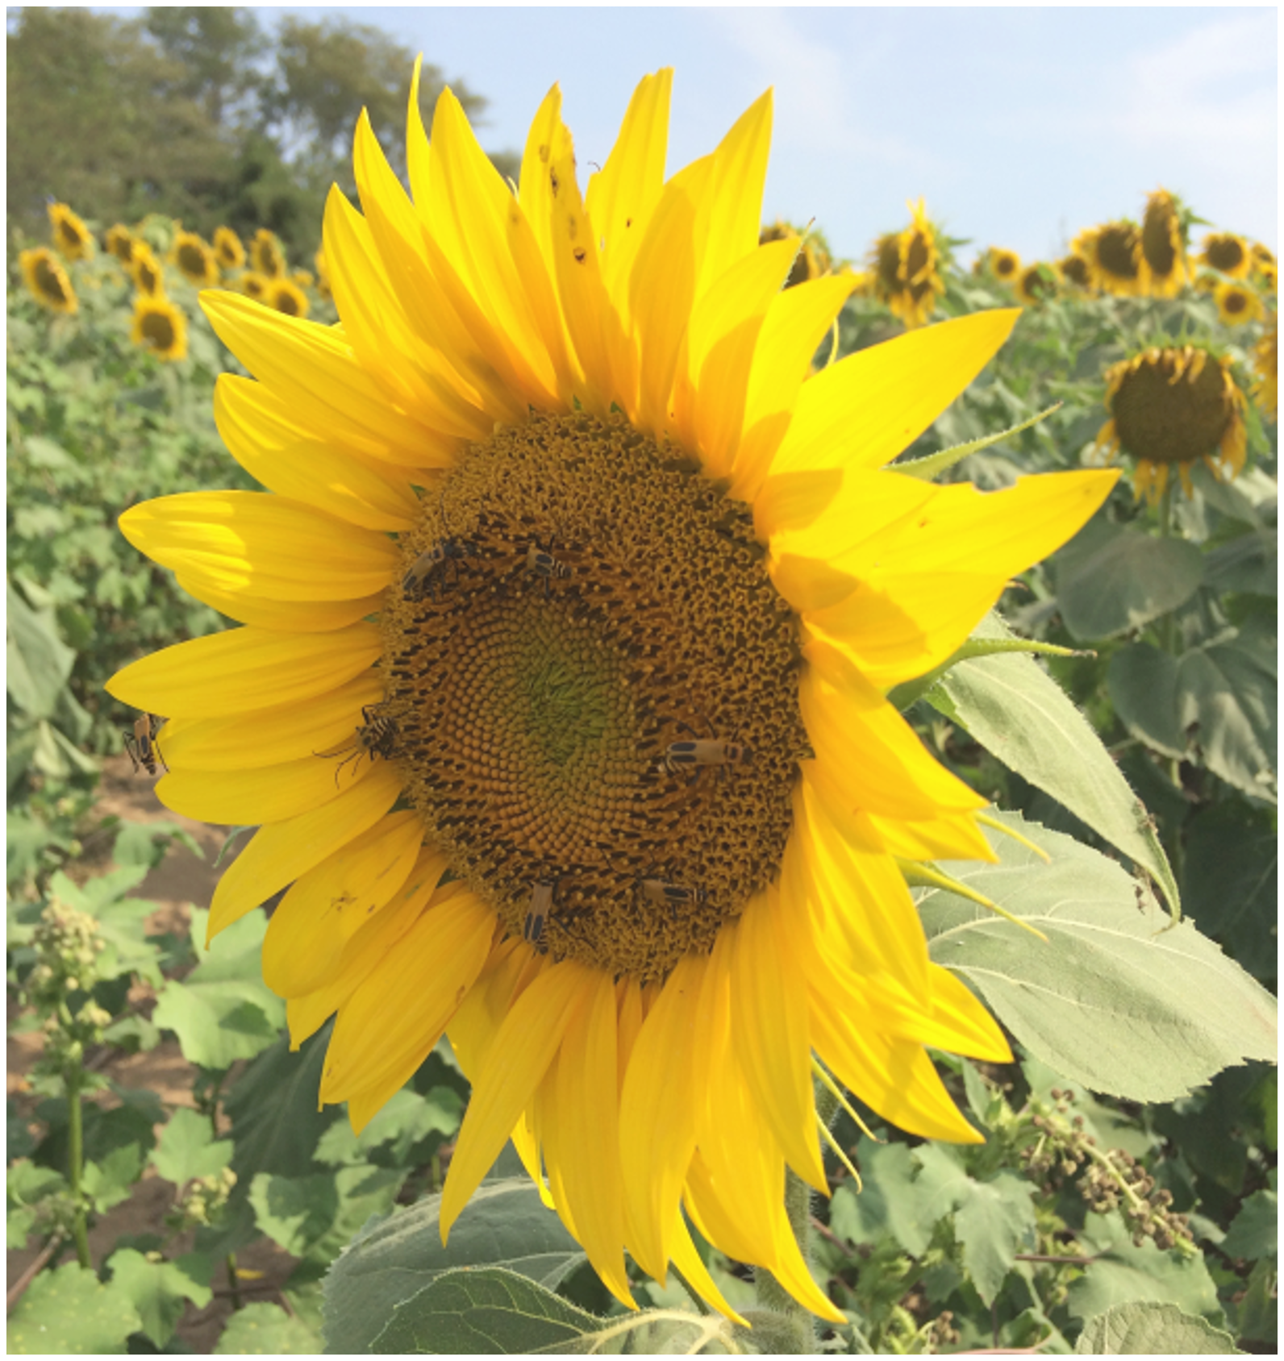
‘’’’
What is a community?
All populations of species living and interacting in the same area and time
individual
population
community
ecosystem
biome
biosphere

Slide 3

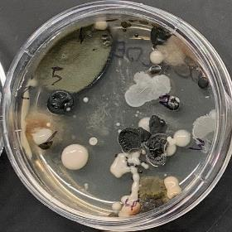
Microbial Communities
Bacteria, Fungi, and more
Communities linked to host health and function
Impacts on hosts have implications for whole ecosystems
Photo credit: Leonora Bittleston

Slide 4
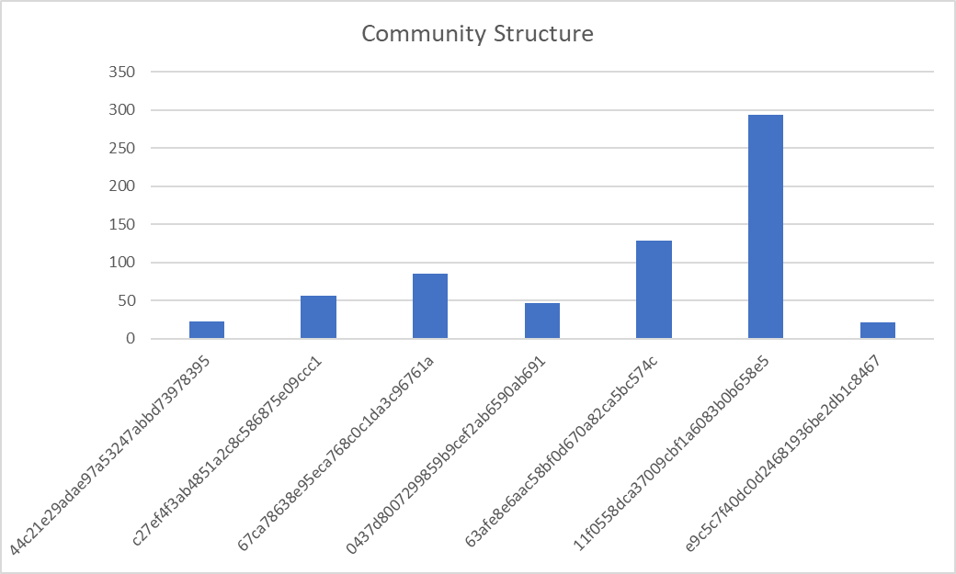
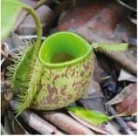
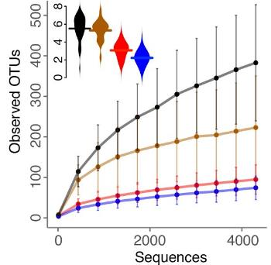
Workflow
Analysis
Create ASVs
DADA2 produces amplicon sequence variants
ASVs are unique sequences in the sample
Previous technology produced operational taxonomic units (OTUs)
These are a proxy for species and their abundance is relative
Extract Community
Normalize Data
PCR
Amplicon
sequencing

Slide 5



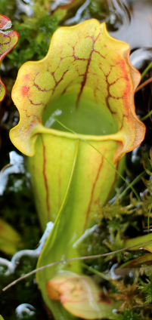
Collect Community
Extract DNA
PCR amplification
using the 16S primer

Slide 6
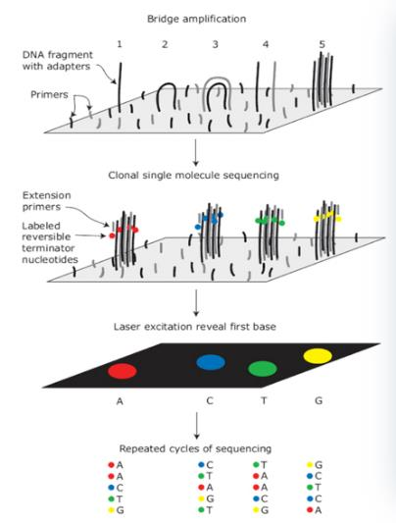
Next Generation Sequencing
Raw data:
the fastq format
Two files for each sample: forward and reverse paired reads
Lines
Identifier
Sequence
+
Quality scores
probability of incorrect base call
scale of 0-40
represented by ASCII symbols in the file
www.well.ox.ac.uk

Slide 7
Workflow
Analysis
Create ASVs
DADA2 produces amplicon sequence variants
ASVs are unique sequences in the sample
Previous technology produced operational taxonomic units (OTUs)
These are a proxy for species and their abundance is relative
Extract Community
Normalize Data
PCR
Amplicon
sequencing

Slide 8
Dada2
determines exact sequences from a sample and corrects for errors in sequencing
Steps
Filter and trim
Visualize data and manually trim low-quality parts of reads
Dereplicate
Reduce identical reads to one
Learn error rates
Use parametric model to predict PCR errors from the data
Infer sample composition
Utilize the DADA2 algorithm to produce amplicon sequence variants (ASVs)
Merge paired (forward and reverse) reads
Make sequence table
Remove chimeras

Slide 9
R Setup

Slide 10
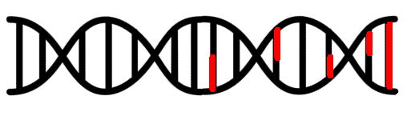
Filter and Trim

Slide 11
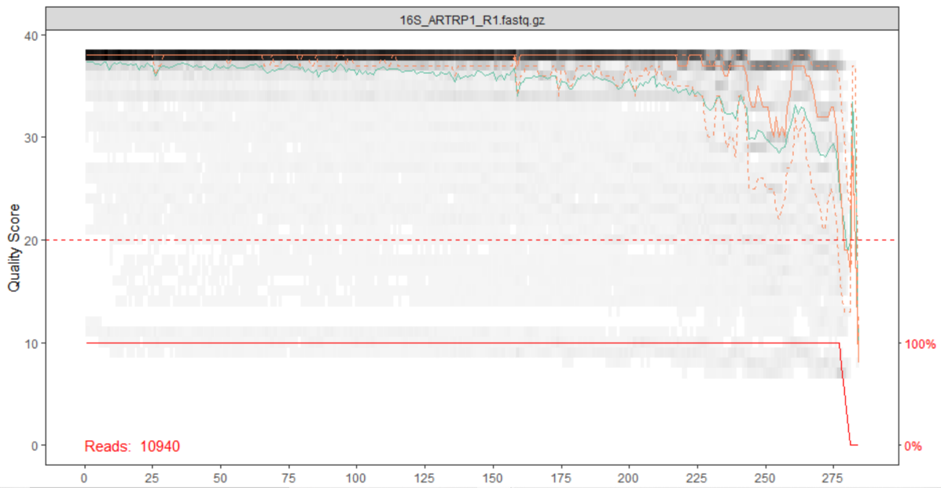
Plot quality of raw data

Slide 12
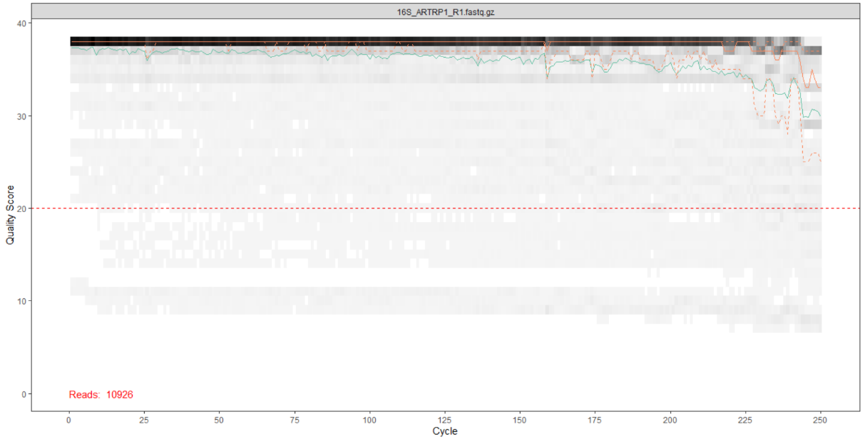
Filter and trim
Notes:
filterAndTrim(fwd = fnFs_16S, filt = filtpath_R1,
rev = fnRs_16S, filt.rev = filtpath_R2,
truncLen = c(225,225), maxEE = c(2,2),
compress = TRUE, verbose = TRUE)

Slide 13
Dereplication
6
5
3
2

Slide 14
Learn Errors +
Infer Sample Composition
6
10
6
10
1
ASV1
ATCGATCGATCGATCGATCG
5
3
5
3
3
12
2
2
1
3
12

Slide 15
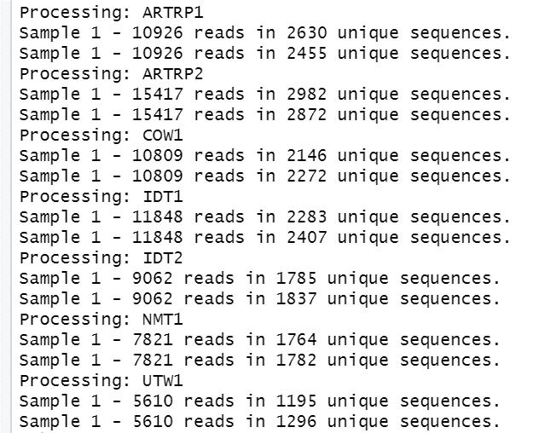
Dereplicate data,
Learn errors,
Infer sample composition

Slide 16
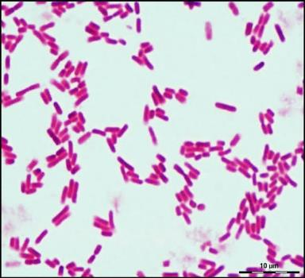
Species
ASV
amplicon sequence variant
exact sequences
OTU
operational taxonomic unit
clustered by percent similarity
Escherichia coli
ASV1
ATCGATCGATCGATCGATCG
OTU1
97%
similarity
ASV2
TAGCATTGATAGATCGACCG
OTU2
97%
similarity
OTU3
ASV3
GCCGATAGATCGATCTCTCG
97%
similarity
Gram-negative
Rod-shaped
Whole genome: 4,639,221-base pairs
OTU4
ASV4
CACGATCGATTGATCGATAG
97%
similarity

Slide 17
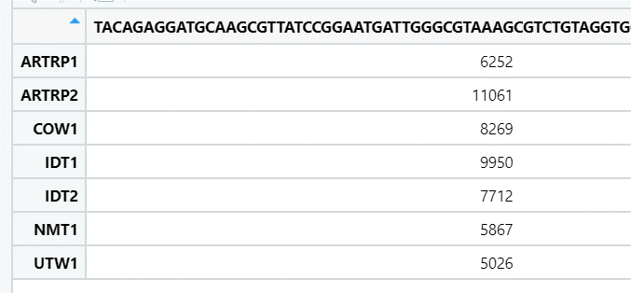
Format data as ASV table

Slide 18
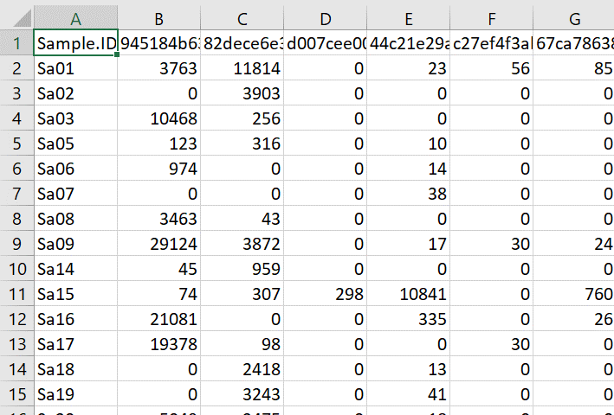
Community data structure
Data
Samples
ASVs
Richness, Abundance

